Slide 1
Monbon.fr
Additional placements opportunities

Slide 2
MEAs
Herein we show all opportunities for additional placements on Monbon.fr
We have the ways to offer placements kits
Some of the presented types have very good results. Upon your request we can show the statistics
For any additional information, please, write to partenariat@monbon.fr
www.monbon.fr

Slide 3
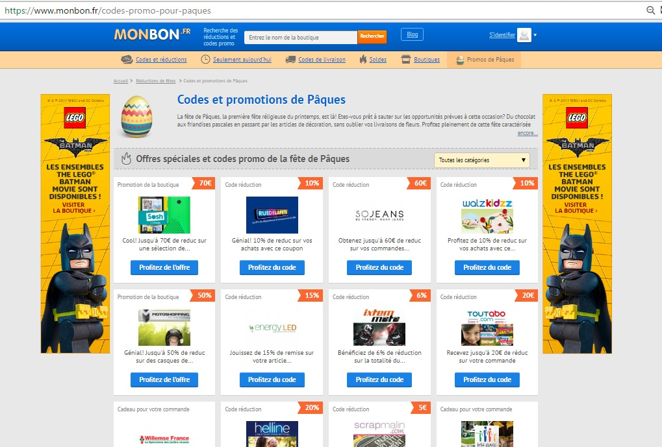
Make the skin of Monbon.fr of your own
1
Make your brand familiar to
…. 25k visitors.
Here is one of the most
commercially active
audience on net.
www.monbon.fr

Slide 4
Your promotion fixed at Top on Homepage
2
Special place for your exclusive
coupon codes / deals
on Homepage
www.monbon.fr

Slide 5
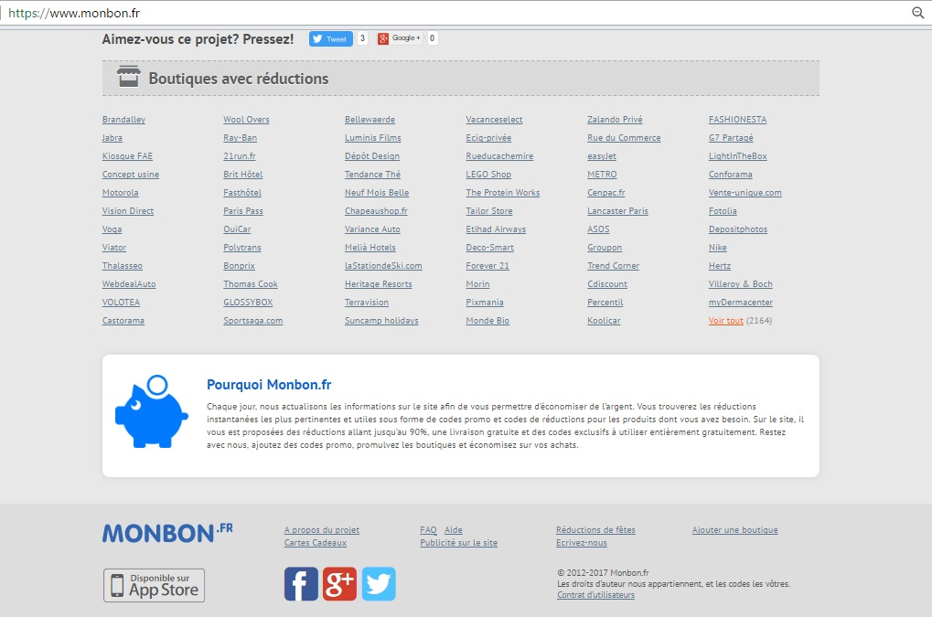
Additional placements of your logo and brand on Homepage
3
Your logo on top slider
and
Linking from Mainpage
www.monbon.fr

Slide 6
Advertise your banner
4
Advertising banner in
Deals categories menu
www.monbon.fr

Slide 7
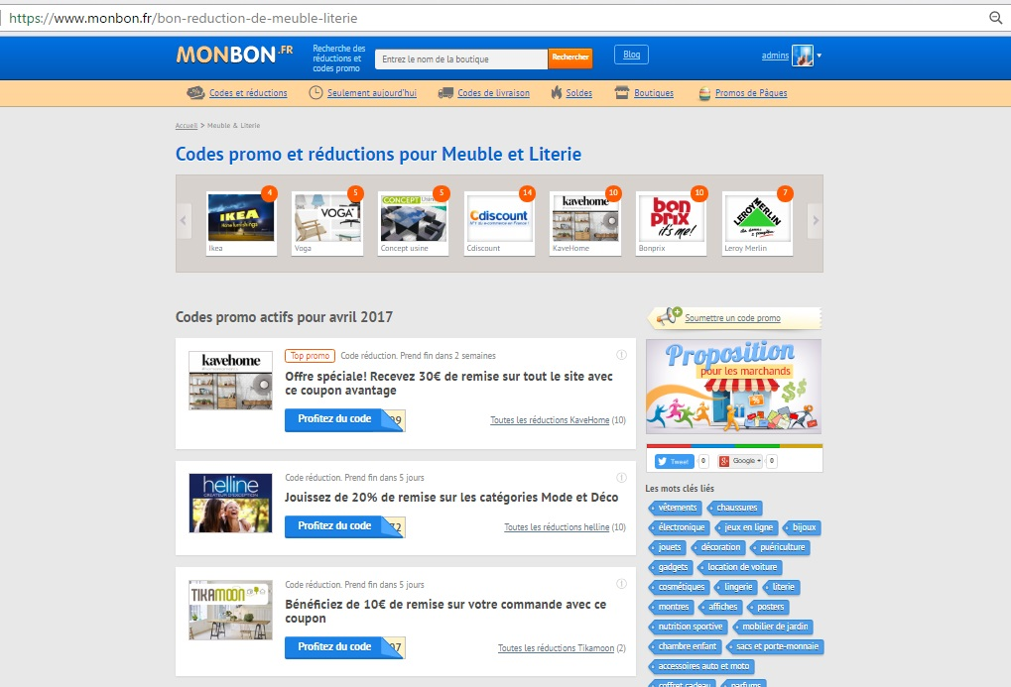
Fix your exclusive code or deal
5
Break the updating rule
on site: new deal / code
is upper
We offer fixing your
promotion at top in
Season deals and in
Deals by categories
www.monbon.fr

Slide 8
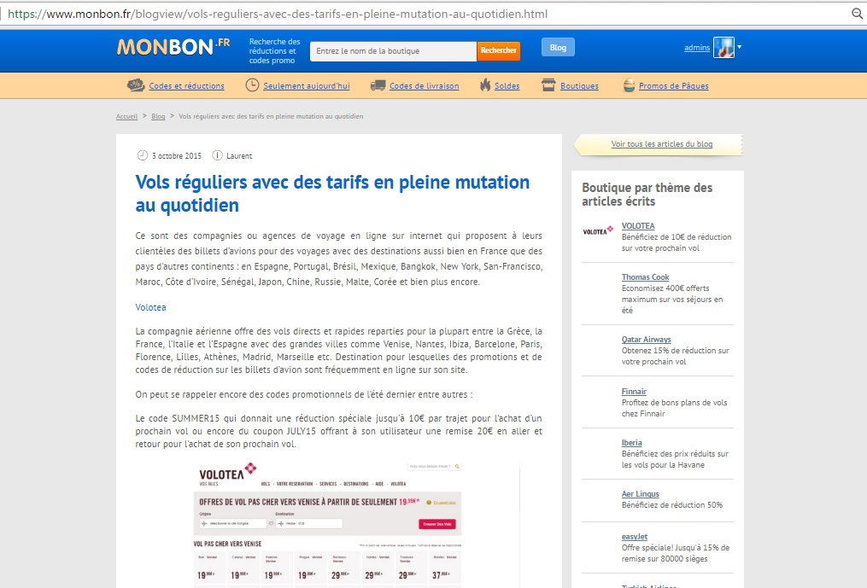
More content – More linking
6
Additional content about
your brand.
Unique and purposive text
on brand page and in blog
www.monbon.fr

Slide 9
Traffic from similar audience
7
Get traffic from pages
with similar audience
Placing the coupon or
Deal on pages of similar
Brands or Websites
www.monbon.fr

Slide 10
Advertise through community subscribers
8
Placing promotion in
weekly newsletter
Of Top 10 week deals
www.monbon.fr

Slide 11
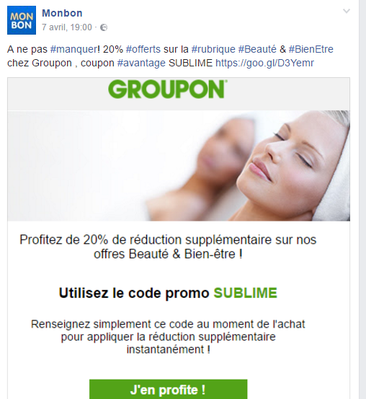
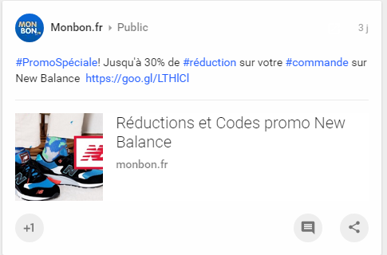
Additional promotion of deals / codes in social networks
9
Social promotion of
exclusive deals and
codes in our groups
www.monbon.fr

